Slide 1
User Research Study 1 “Other” Resources
Prepared by the Digital Service at Veterans Affairs (DSVA)
Prepared for and presented to the VA Web Brand Consolidation Working Group
April 2018

Slide 2
Outline
We wanted to learn how we could organize the “other” resources on va.gov.
1. Study Objectives
2. Research Method
3. Findings
4. Recommendations

Slide 3
1. Study Objectives

Slide 4
Our goal was to learn how to organize the "other" resources that don’t fit into the benefit categories.
Study objectives
Do we need to create additional benefit categories?
How do we treat edge case content/audience based content?
What labels work for these resources?

Slide 5
2. Research Method

Slide 6
We let Veterans tell us how they would group the “other” resources
Research Method
Created an open card sort in Optimal Workshop
20 cards, user creates categories
Distributed to 4k Veterans via MyHealtheVet mailing list
Received 155 responses (Apr 5 – Apr 20)
95% Veterans, a few caregivers and family members

Slide 7
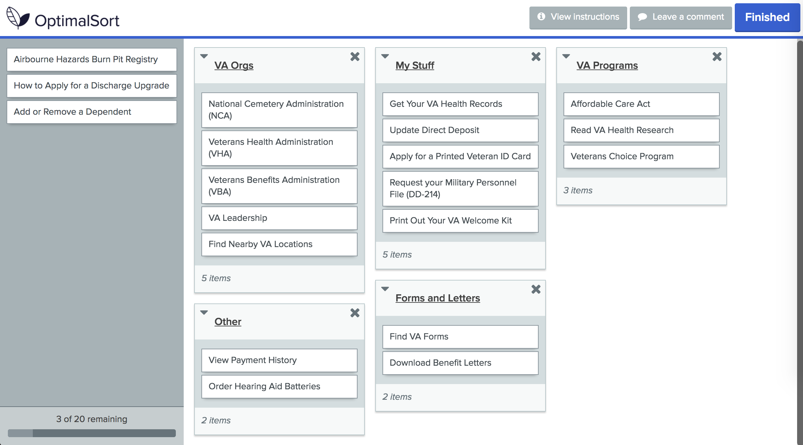
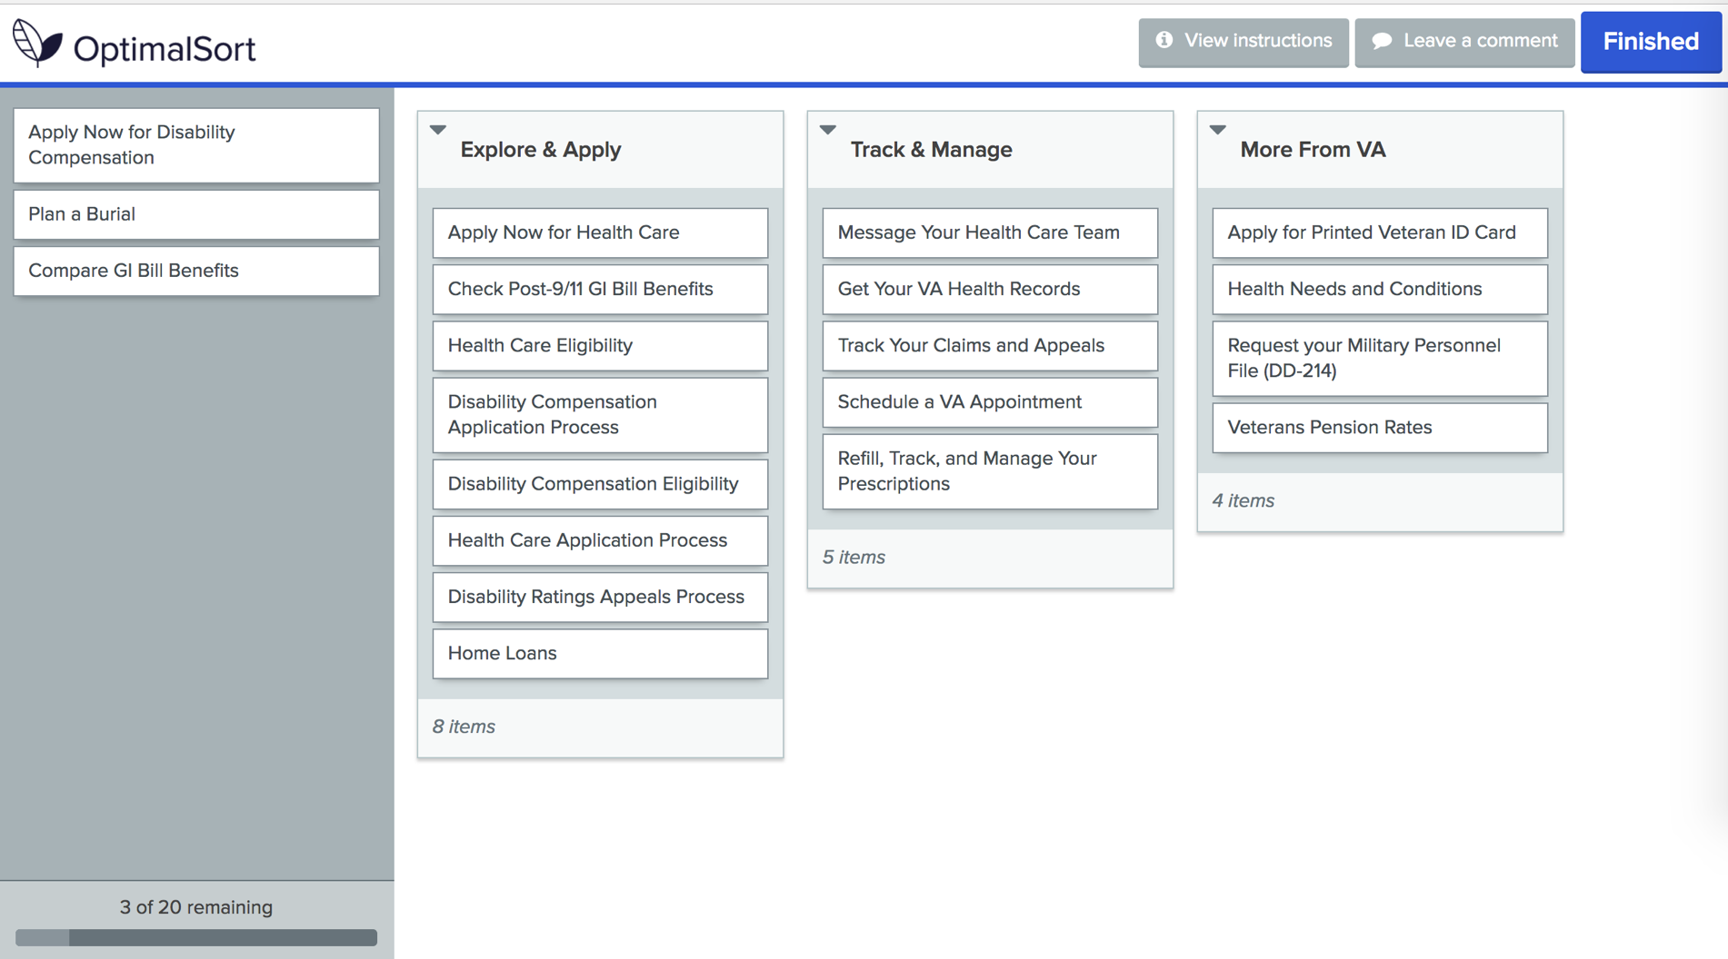

Slide 8
3. Findings

Slide 9
Veterans don’t agree on what to call these groups of content
Findings
Veteran’s groups had low agreement scores but provide valuable labels
Account Information / Management
About the VA
My VA / For Me
Most Important (focused on health due to audience)
Self Service / Online
Airborne Hazards and Ordering Hearing Aid Batteries were consistently outliers

Slide 10
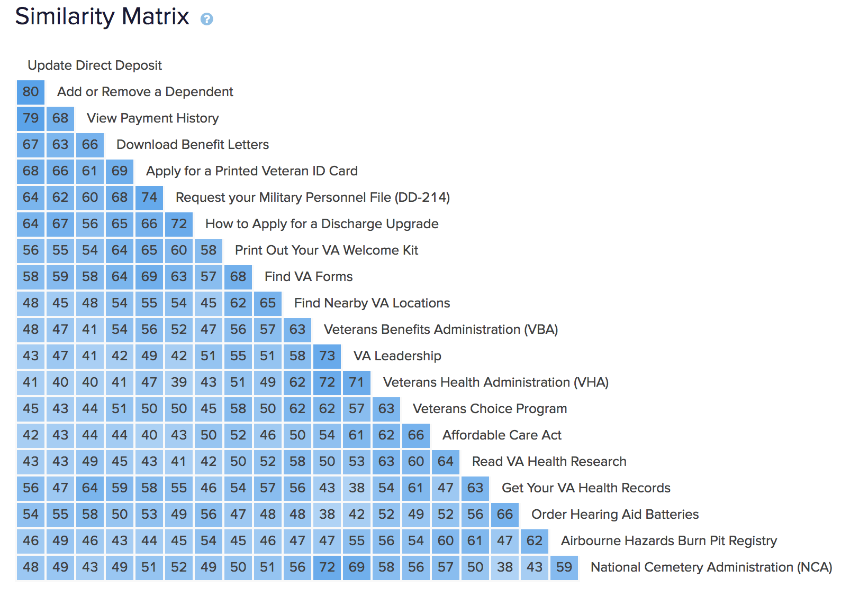
Veterans did not have a consistent way of organizing “other” benefits

Slide 11
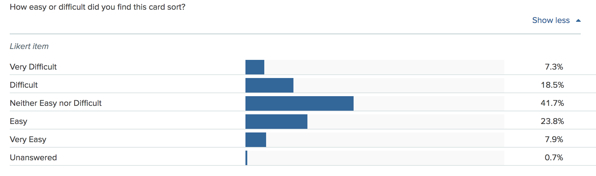
Veterans had a neutral response to the activity’s difficulty

Slide 12
4. Recommendations

Slide 13
What Now?
Recommendations
We confirmed that there is no clear or consistent way to group and label all the “other” content but the data still show items with the strongest relationship and provide Veteran-focused labels.

Slide 14
Groupings of items with the highest similarity
Group 1
Group 2
Group 3
Update Direct Deposit
Add or Remove a Dependent
View Payment History
Download Benefit Letters
Apply for a Printed Veteran ID Card
Request your Military Personnel File (DD-214)
How to Apply for a Discharge Upgrade
Find VA Forms
Find Nearby VA Locations

Slide 15
Groupings of items with the highest similarity
Group 4
Group 5
Group 6
Veterans Benefits Administration (VBA)
VA Leadership
Veterans Health Administration (VHA)
National Cemetery Administration (NCA)
Veterans Choice Program
Affordable Care Act
Read VA Health Research
Get Your VA Health Records
Order Hearing Aid Batteries

Slide 16
Thank you!
Contact Jeff Barnes with questions:
jeffrey.barnes4@va.gov

Slide 17
Did we answer our research questions?
Study objectives
Do we need to create additional benefit categories? Yes, the “other resources” need to be matrixed into benefit categories and new categories like “Records” need to be added.
How do we treat edge case content/audience based content? We need to use crosslinking and personalization to deliver this content.
What labels work for these resources? There is no clear strategy for labeling all “other” content, but sub-groups of 2-3 items can be combined and labeled.

